Slide 1
Data Visualization Part 3

Slide 2
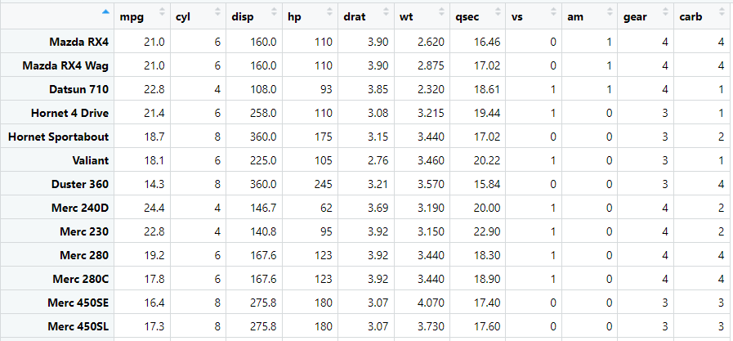
Data 1 - mtcars

Slide 3
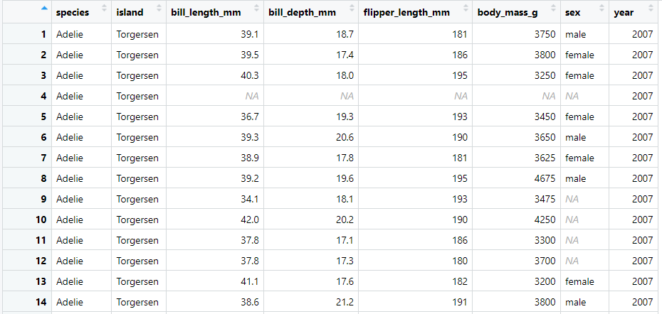
Data 2 - penguins

Slide 4
Changing Colors in Plots
Univariate Displays

Slide 5
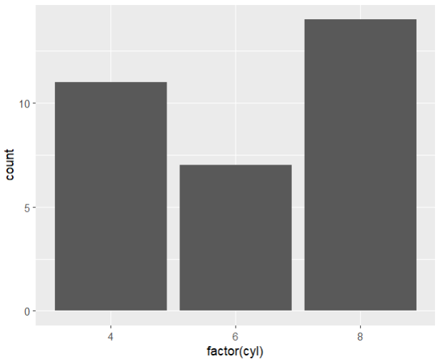
Example 1: Univariate simple bar graph (no color)
fig_1 <- mtcars %>%
ggplot(aes(x = factor(cyl))) +
geom_bar()
fig_1

Slide 6
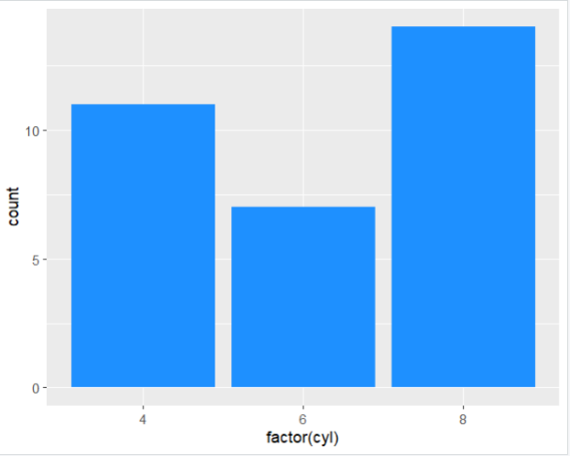
Example 2: Fills all the bars with the same color.
fig_2 <- mtcars %>%
ggplot(aes(x = factor(cyl))) +
geom_bar(fill = "dodgerblue")
fig_2

Slide 7
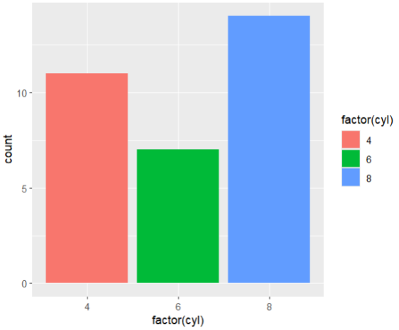
Example 3: Change each bar to a different color using fill inside "aes"
fig_3 <- mtcars %>%
ggplot(aes(x = factor(cyl),
fill = factor(cyl))) +
geom_bar()
fig_3

Slide 8
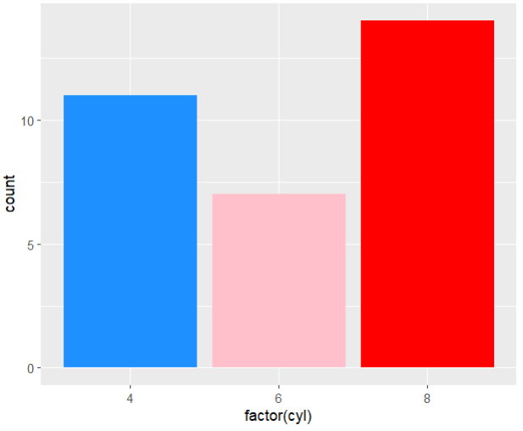
Example 4: Change each bar to a different color without the legend.
fig_4 <- mtcars %>%
ggplot(aes(x = factor(cyl))) +
geom_bar(fill = c("dodgerblue", "pink", "red"))
fig_4

Slide 9
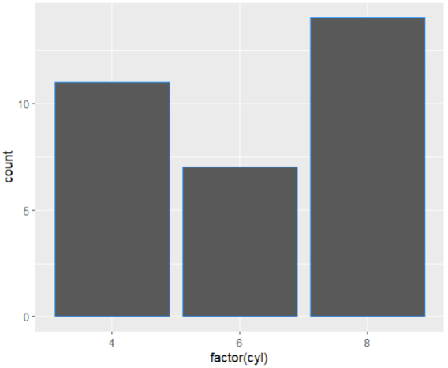
Example 5: Attempt to change bar color using color instead of fill. What happens?
fig_5 <- mtcars %>%
ggplot(aes(x = factor(cyl))) +
geom_bar(color = "dodgerblue")
fig_5

Slide 10
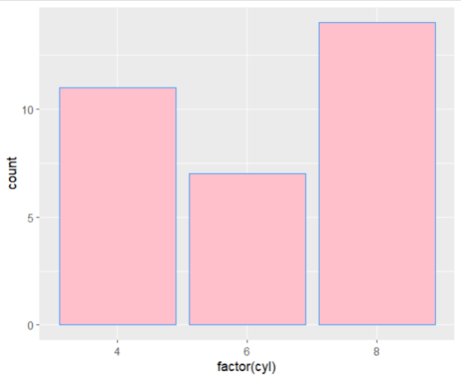
Example 6: Change the lines of the bars to dodgerblue and the bar colors to pink.
fig_6 <- mtcars %>%
ggplot(aes(x = factor(cyl))) +
geom_bar(fill = "pink", color = "dodgerblue")
fig_6

Slide 11
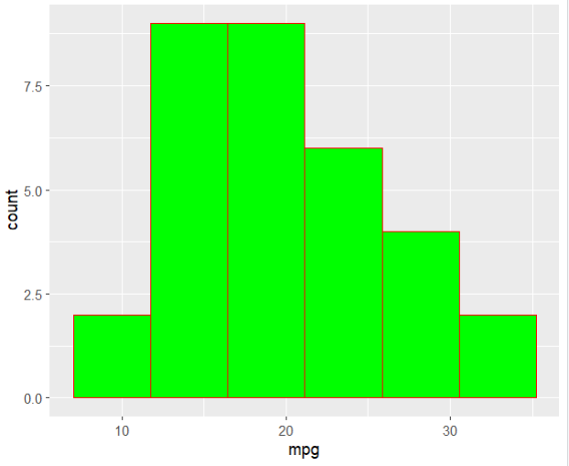
Example 7: Create a histogram for mpg variable with 6 bins. Then, change the lines of the histogram to red and the bar colors to green.
fig_7 <- mtcars %>%
ggplot(aes(x = mpg)) +
geom_histogram(bins = 6, fill = "green", color = "red")
fig_7

Slide 12
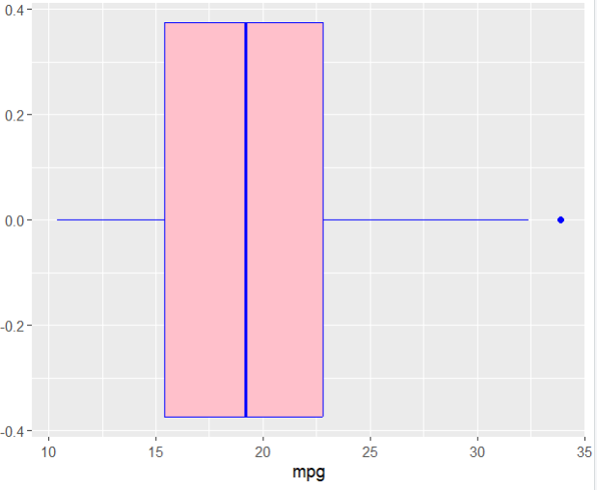
Example 8: Create a boxplot for mpg variable. Then, change the lines of the plot to blue and the inside colors to pink.
fig_8 <- mtcars %>%
ggplot(aes(x = mpg)) +
geom_boxplot(color = "blue", fill = "pink")
fig_8

Slide 13
Multivariate Displays
scale_fill_manual(): manually changes fill in the aes.
scale_color_manual(): manually changes color in the aes.

Slide 14
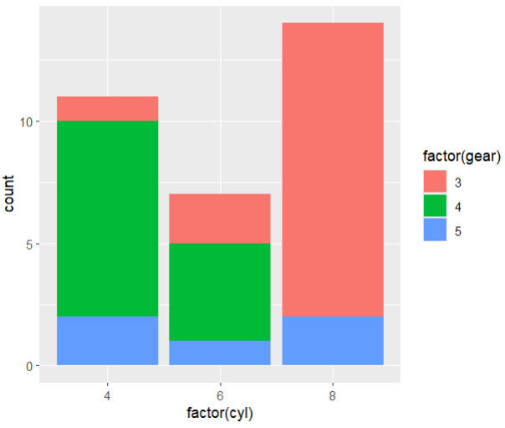
Example 9: Create a stacked bar graph with cyl in the x axis and gear as the categorical variable to split each column.
fig_9 <- mtcars %>%
ggplot(aes(x = factor(cyl), fill = factor(gear)))+
geom_bar()
fig_9

Slide 15
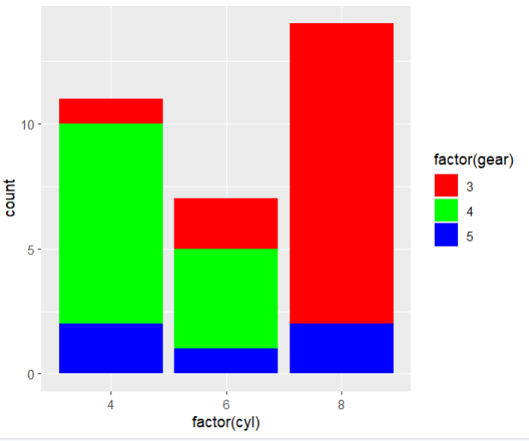
Example 10: Change the colors from Example 9 to red, green, and blue (in that order).
fig_10 <- mtcars %>%
ggplot(aes(x = factor(cyl), fill = factor(gear)))+
geom_bar()+
scale_fill_manual(values = c("red", "green", "blue"))
fig_10

Slide 16
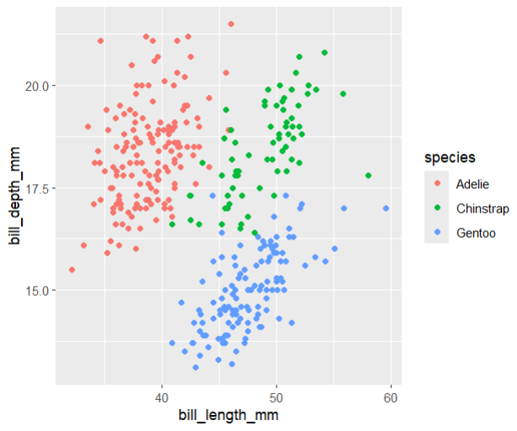
Example 11: Create a scatter plot with x = bill_length_mm, y = bill_depth_mm, and species as the categorical variable.
fig_11 <- penguins %>%
ggplot(aes(x = bill_length_mm,
y = bill_depth_mm,
color = species)) +
geom_point()
fig_11

Slide 17

Example 12: Change the colors from Example 11 to red, green, and blue, in that order. What is wrong with these codes? Why isn't this one working?
fig_12 <- penguins %>%
ggplot(aes(x = bill_length_mm,
y = bill_depth_mm,
color = species)) +
geom_point() +
scale_fill_manual(values = c("red", "green", "blue"))
fig_12

Slide 18
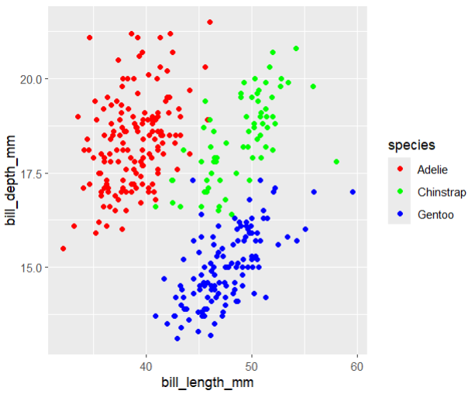
Example 13: Change the colors from Example 11 to red, green, and blue, in that order.
fig_13 <- penguins %>%
ggplot(aes(x = bill_length_mm,
y = bill_depth_mm,
color = species)) +
geom_point() +
scale_color_manual(values = c("red", "green", "blue"))
fig_13

Slide 19
Using External Color Packages
`wesanderson` & `viridis`

Slide 20
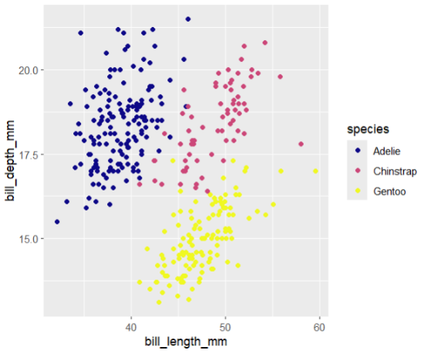
Example 14: Create a scatter plot with x = bill_length_mm, y = bill_depth_mm, and species as the categorical variable. Use the viridis package to change the colors.
fig_14 <- penguins %>%
ggplot(aes(x = bill_length_mm, y = bill_depth_mm, color = species)) +
geom_point() +
scale_color_viridis(discrete = TRUE, option = "C", alpha = 1)
fig_14

Slide 21
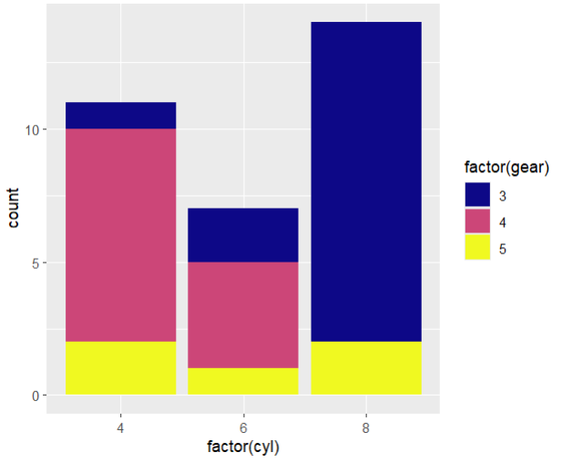
Example 15: Create a stacked bar graph with cyl in the x axis and gear as the categorical variable to split each column. Use the viridis package to change the colors.
fig_15 <- mtcars %>%
ggplot(aes(x = factor(cyl), fill = factor(gear)))+
geom_bar() +
scale_fill_viridis(discrete = TRUE, option = "C", alpha = 1)
fig_15

Slide 22
Themes
theme_gray():
2. theme_bw():
3. theme_minimal():
4. theme_void():

Slide 23
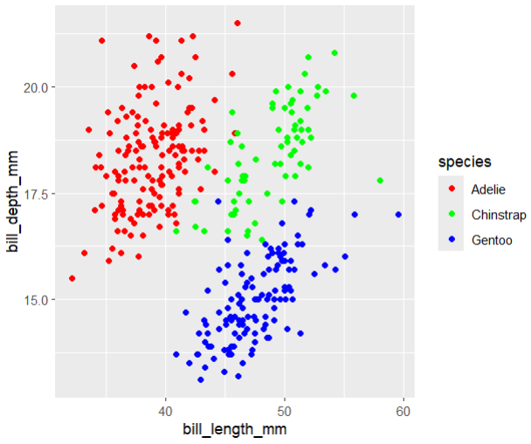
Example 16: Create a scatter plot with x = bill_length_mm, y = bill_depth_mm, and species as the categorical variable. Use a gray theme
fig_16 <- penguins %>%
ggplot(aes(x = bill_length_mm,
y = bill_depth_mm,
color = species)) +
geom_point() +
scale_color_manual(values = c("red", "green", "blue")) +
theme_gray()
fig_16

Slide 24
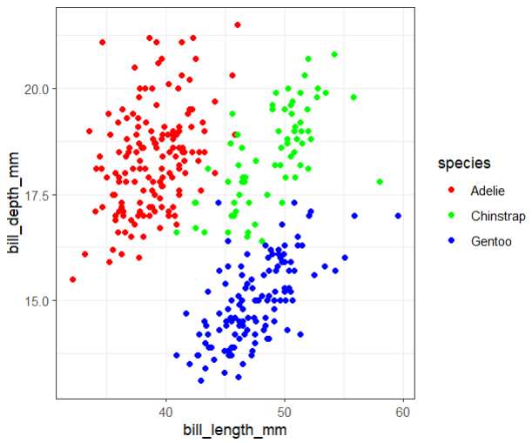
Example 17: Create a scatter plot with x = bill_length_mm, y = bill_depth_mm, and species as the categorical variable. Use a black and white theme
fig_17 <- penguins %>%
ggplot(aes(x = bill_length_mm,
y = bill_depth_mm,
color = species)) +
geom_point() +
scale_color_manual(values = c("red", "green", "blue")) +
theme_bw()
fig_17

Slide 25
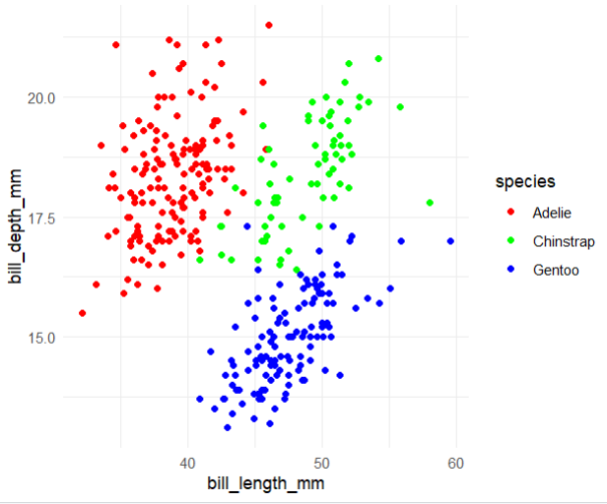
Example 18: Create a scatter plot with x = bill_length_mm, y = bill_depth_mm, and species as the categorical variable. Use a minimal theme.
fig_18 <- penguins %>%
ggplot(aes(x = bill_length_mm,
y = bill_depth_mm,
color = species)) +
geom_point() +
scale_color_manual(values = c("red", "green", "blue")) +
theme_minimal()
fig_18

Slide 26
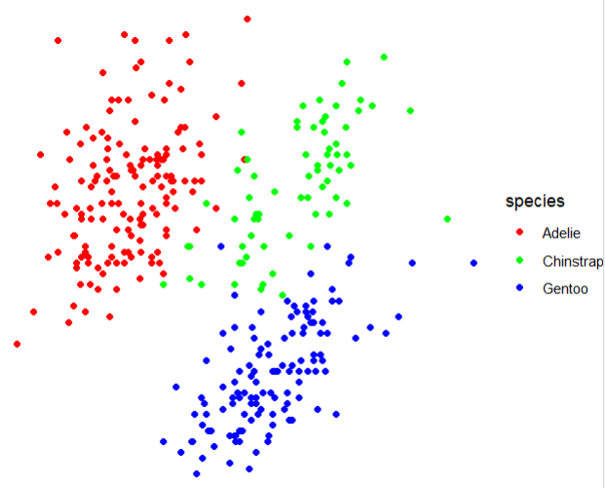
Example 19: Create a scatter plot with x = bill_length_mm, y = bill_depth_mm, and species as the categorical variable. Use a void theme.
fig_19 <- penguins %>%
ggplot(aes(x = bill_length_mm,
y = bill_depth_mm,
color = species)) +
geom_point() +
scale_color_manual(values = c("red", "green", "blue")) +
theme_void()
fig_19

Slide 27
Customizing Labels with labs()
`labs()` function in ggplot2

Slide 28
Example 20: Customizing Plot Labels
fig_20 <- penguins %>%
ggplot(aes(x = bill_length_mm, y = bill_depth_mm, color = species)) +
geom_point() +
labs(
title = "Scatter Plot of Bill Length vs. Bill Depth",
x = "Length of Bill (mm)",
y = "Depth of Bill (mm)",
subtitle = "Data from the PalmerPenguins dataset",
caption = "Source: Penguin Data",
color = "La La La"
)
fig_20

Slide 29
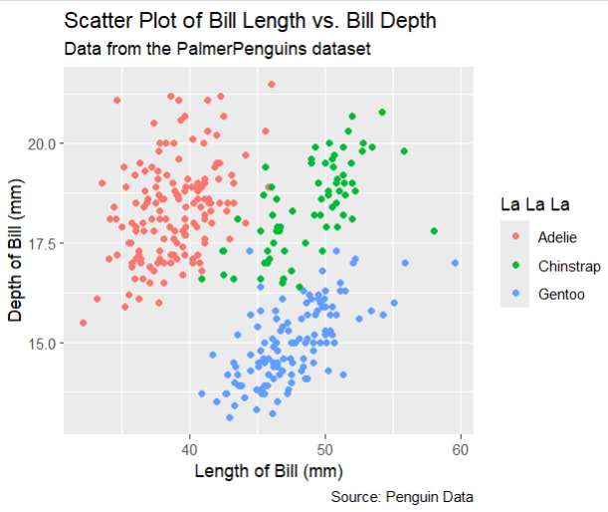

Slide 30
Example 21: Customizing Plot Labels
fig_21 <- mtcars %>%
ggplot(aes(x = factor(cyl), fill = factor(gear)))+
geom_bar() +
labs(
title = "Bar Graph",
x = "Cylinders",
y = "Total Number",
fill = "La La La"
)
fig_21

Slide 31
